Slide 1
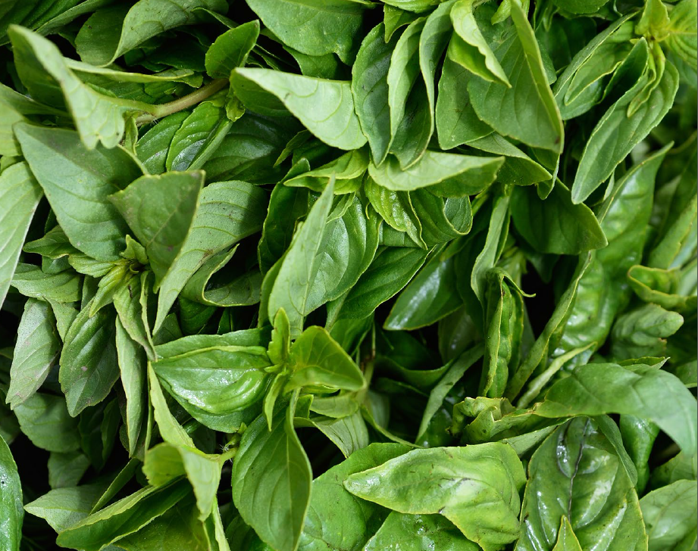
Living With Food In The 21st Century Food systems and preventing waste November 18, 2019
Notes:
photo:
ReFED

Slide 2
Who are we?
Lake Thelen, Youth Education Specialist (Secondary Programs)
Jon Mayer, Education Programs Manager
Thank you for having us!
Notes:
Jon – Metro
All - Intros

Slide 3
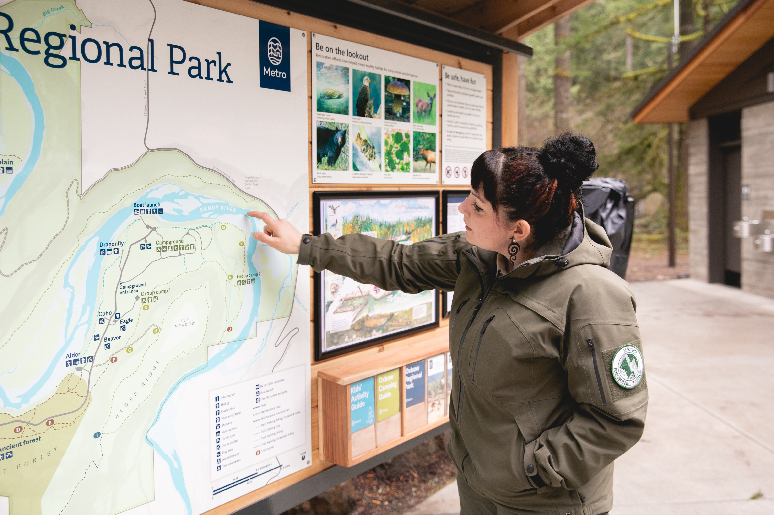
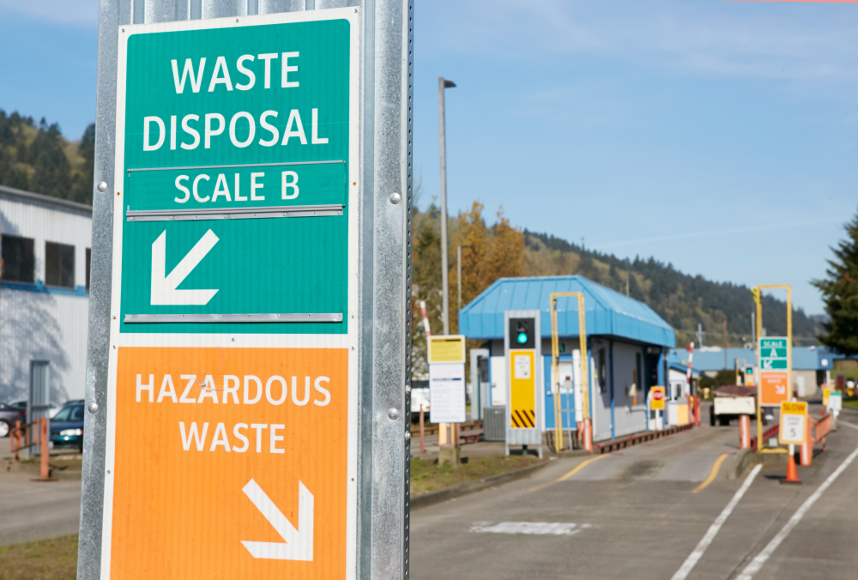
…And what is Metro?

Slide 4
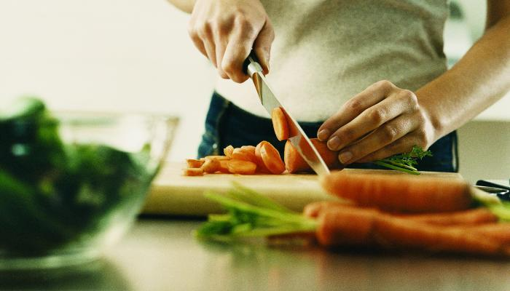
Last year: Plan, shop, chop!

Slide 5
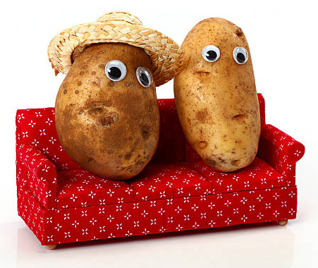
Today we will …
Understand why preventing food waste matters
Simulate two extension activities you can use with students
Food systems concept map
Banana production chain activity
Share additional food waste prevention curriculum resources

Slide 6
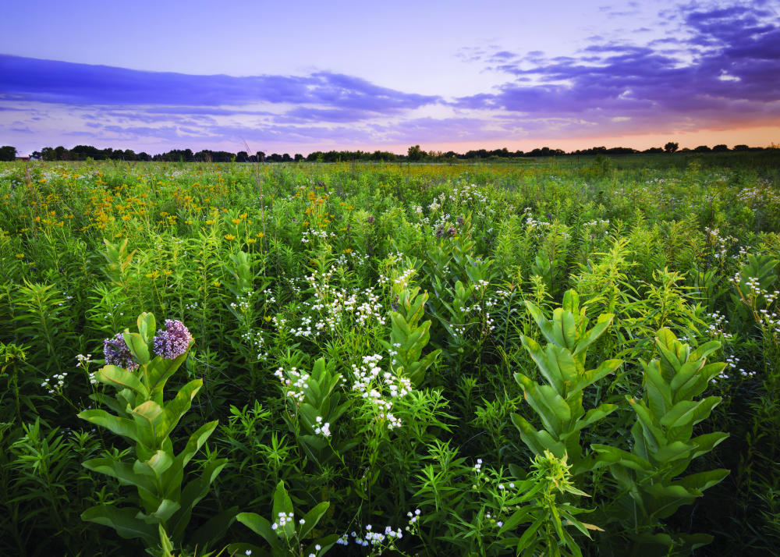
Why do we care about food waste?

Slide 7
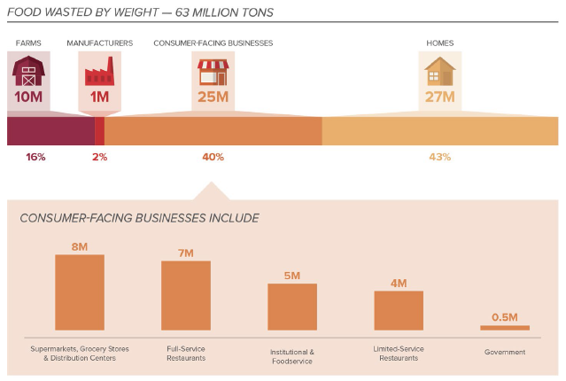
Restaurants play a role

Slide 8
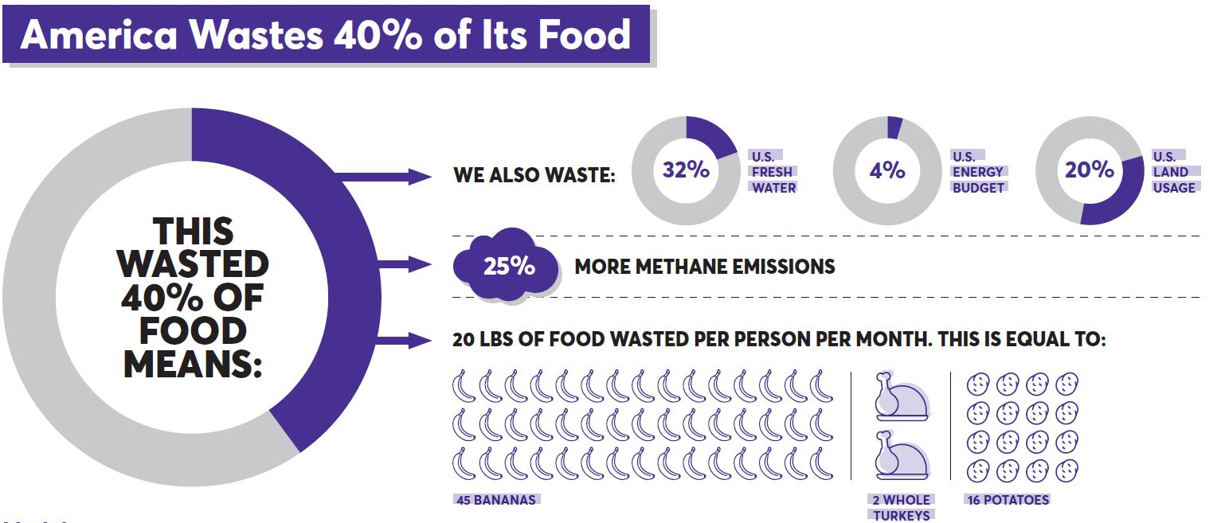
What does food waste represent?
Image from the James Beard Foundation

Slide 9
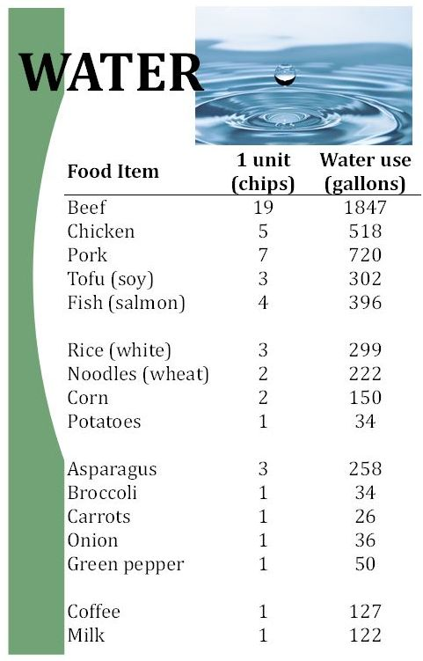
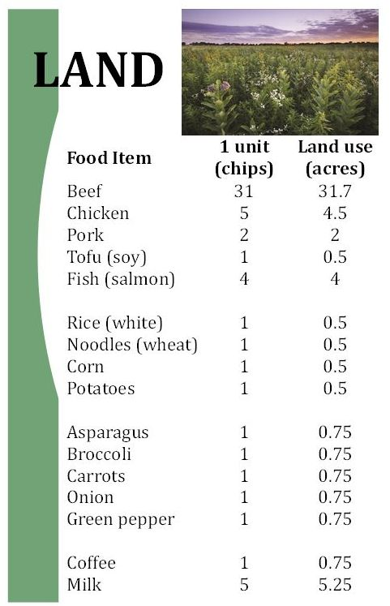
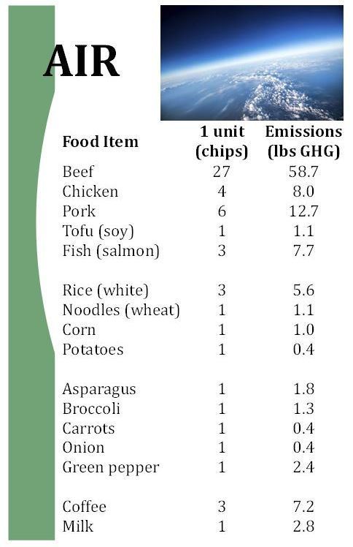
Natural resource use

Slide 10
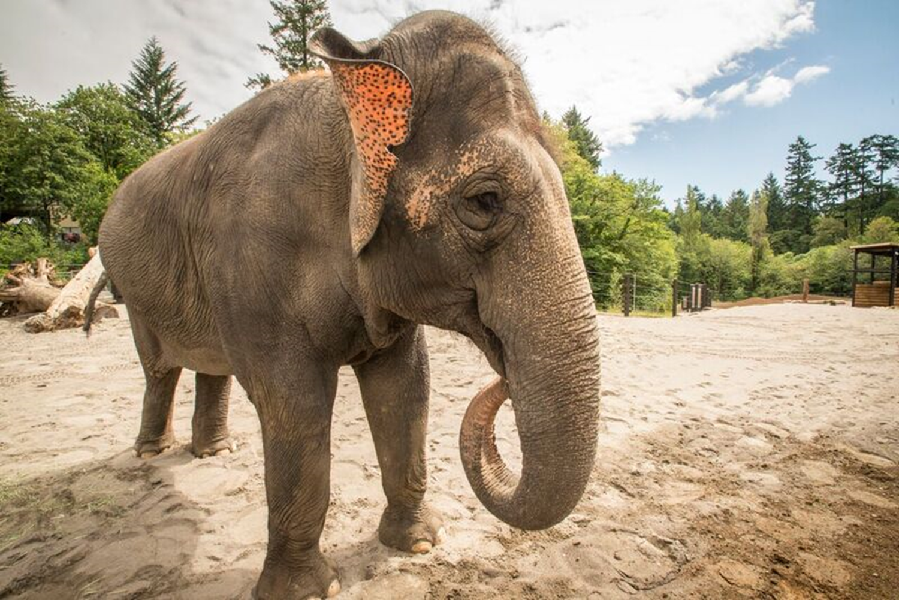
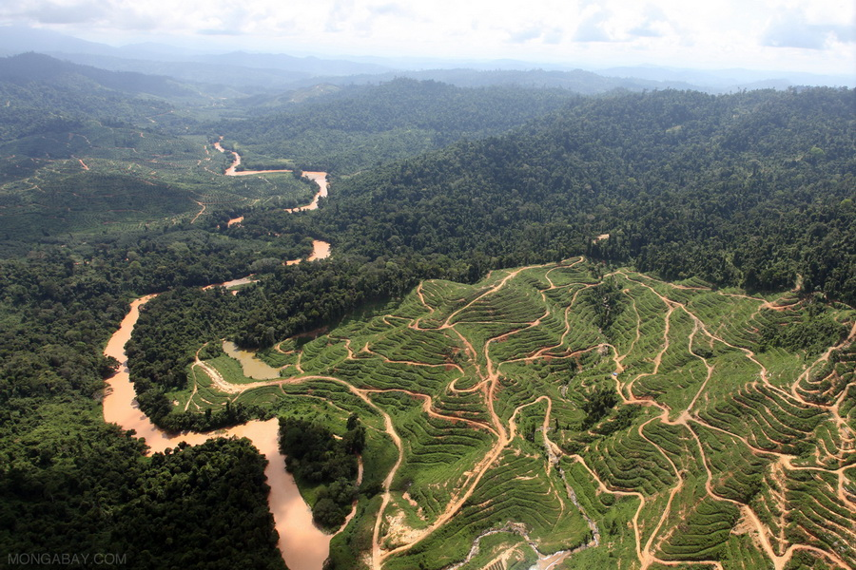
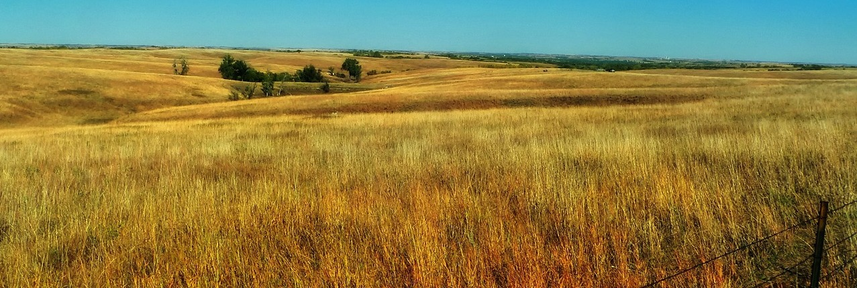
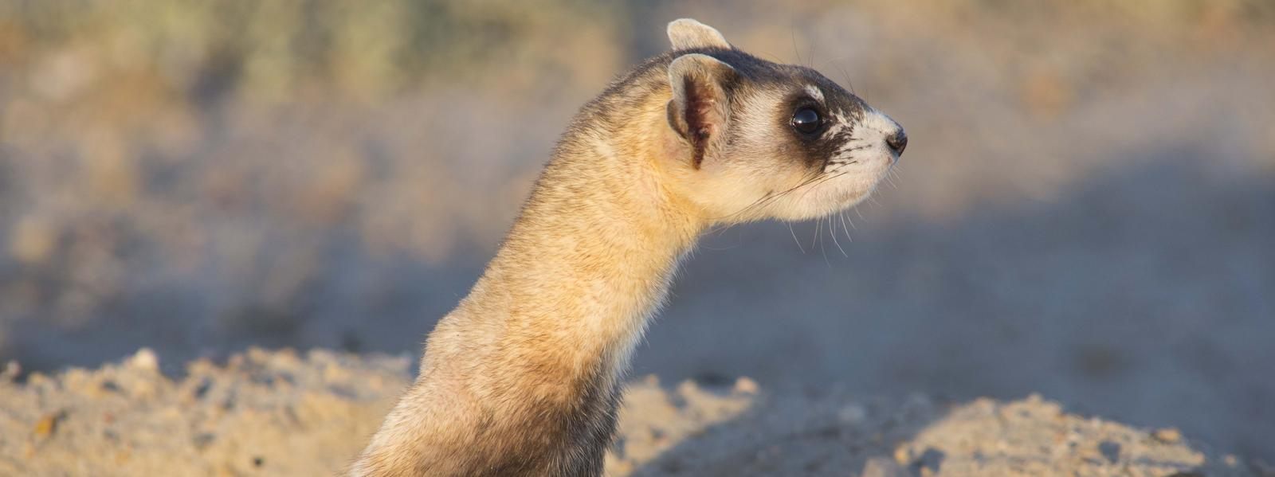
Who else uses that land?
Notes:
Nearly 70% of the Sumatran elephant’s habitat has been destroyed in one generation, due to palm oil plantations.
The United States used more than 75 million acres of land to grow soy in 2013-2014. That’s an area larger than the state of Arizona! (black footed ferret)

Slide 11
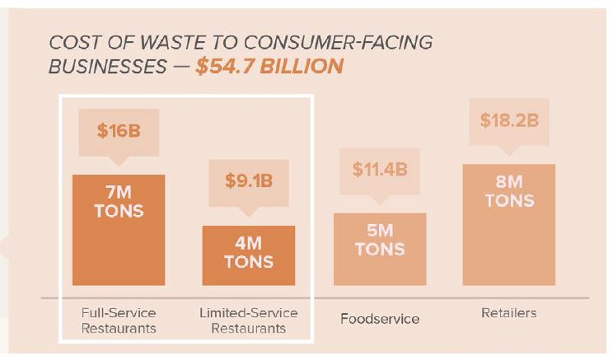
The cost is huge!
Image from REfed
Notes:
Lake

Slide 12
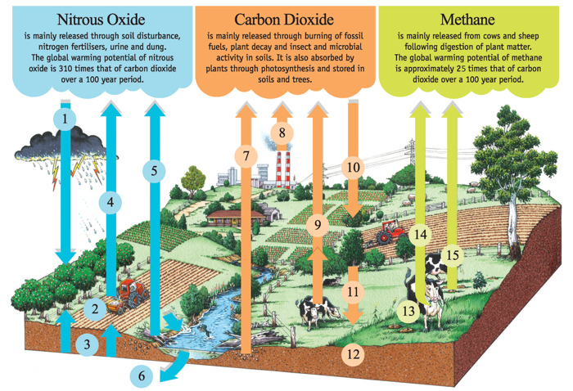
Climate disruption
Agricultural production causes 19-29% of greenhouse gas emissions!
Image from Victoria Agriculture:
www.agriculture.vic.gov.au
Notes:
How many arrows going up?
Agricultural production accounts for
19 - 29%
of global human-caused
greenhouse gas emissions
(Vermeulen et al., 2012).

Slide 13
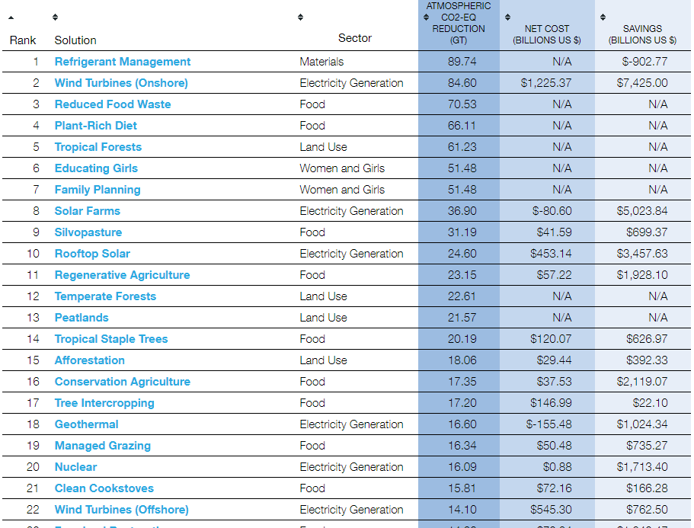
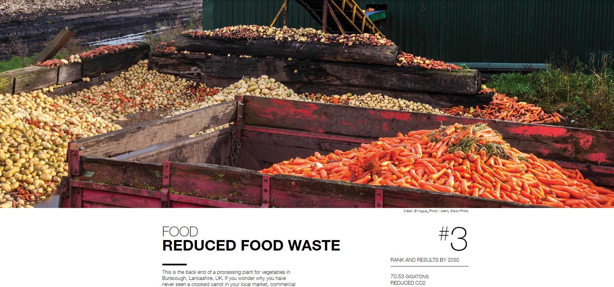
Drawdown: climate solutions
Notes:
This is a list of 80!!

Slide 14
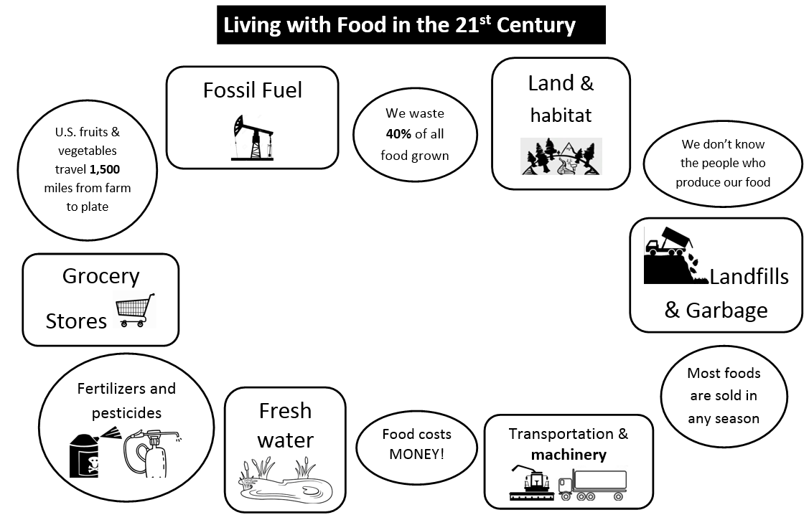

Slide 15
Which items could you replace to make the system more sustainable?

Slide 16
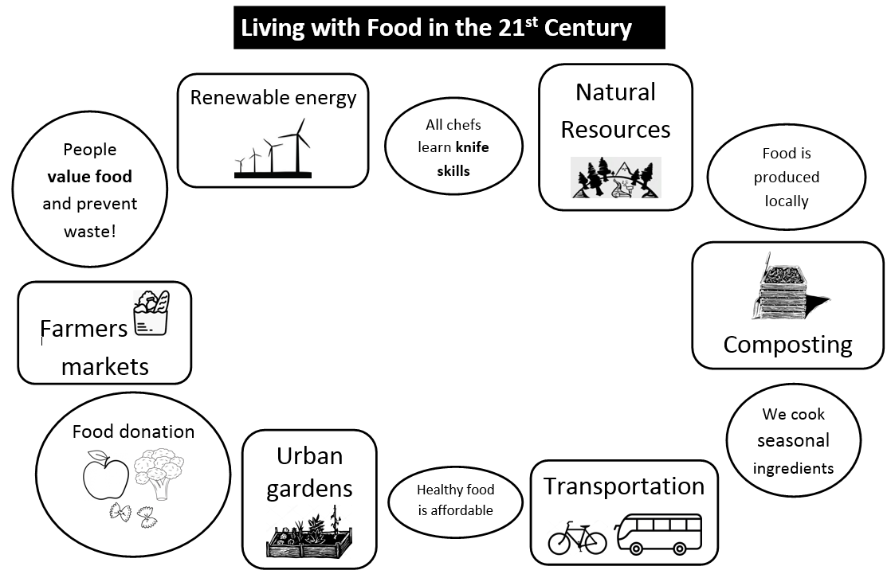

Slide 17
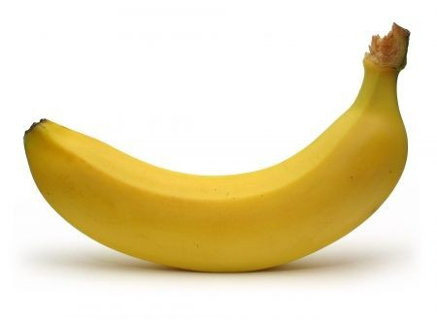
The world of a banana

Slide 18
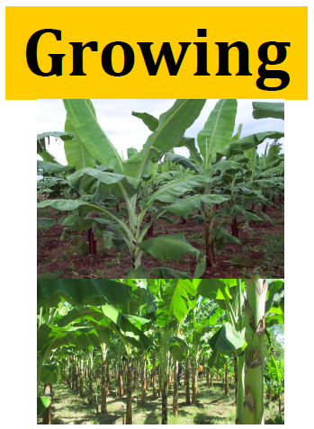
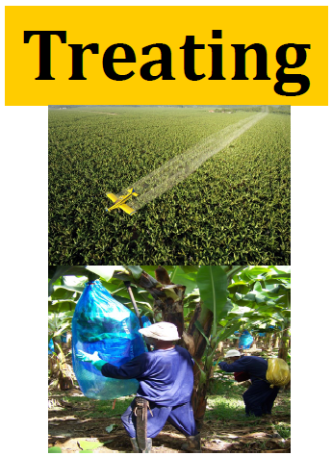
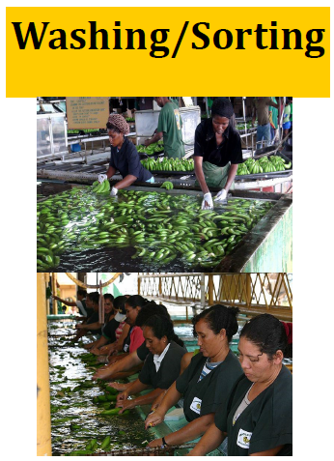
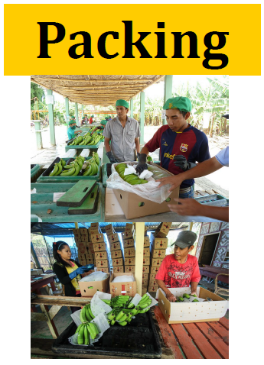
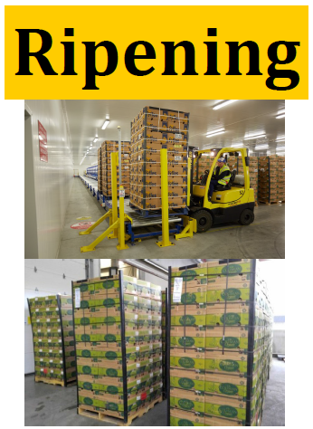
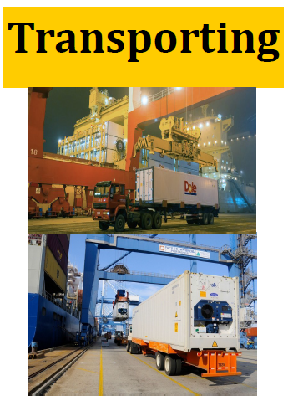
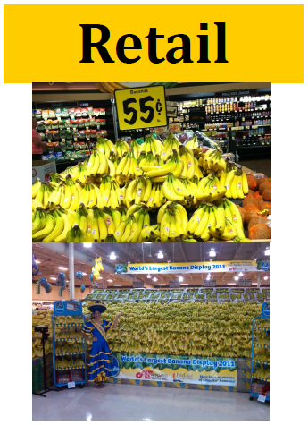
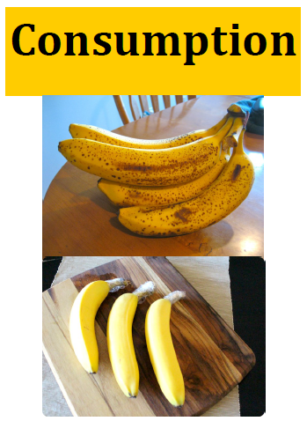
The world of a banana

Slide 19
The world of a banana
In the banana production chain:
How were resources being used?
What other impacts (environmental and human) did you see?
How could these impacts be minimized?

Slide 20
On the tour … which of these might you see?

Slide 21
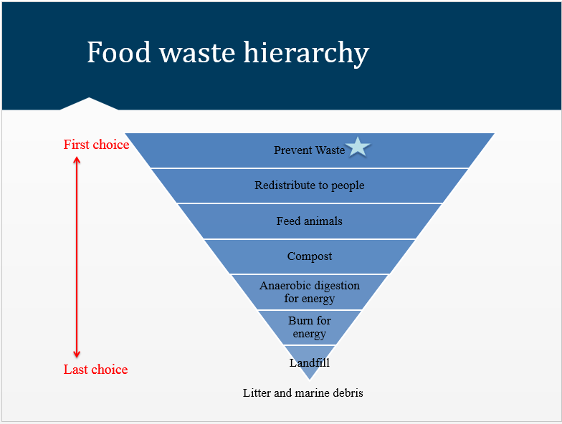
Last year: Plan, Shop, Chop!

Slide 22
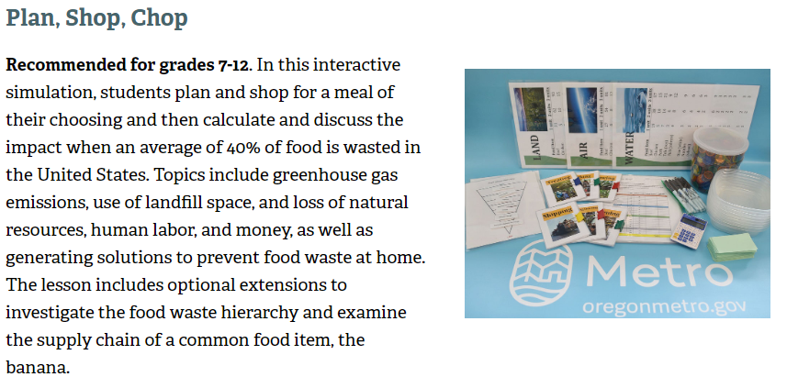
Reserve the education kit
…plus other lessons!
Search “curriculum resources” at www.oregonmetro.gov

Slide 23
Resources
What we brought today
World Wildlife Fund “Food Waste Warriors” 3-part lesson
Rethinking’s Schools “Food, Farming, and Justice” Via Campesina role play
Includes an excellent list of facts on food
Food First “Hunger Myths”
Notes:
http://www.worldwildlife.org/FoodWasteWarriors
https://www.zinnedproject.org/materials/food-farming-and-justice-a-role-play-on-la-via-campesina/

Slide 24
Resources
Additional information
ReFED Restaurant Sustainability guide
https://www.refed.com/downloads/Restaurant_Guide_Web.pdf
Eat Smart, Waste Less challenge
www.eatsmartwasteless.com
Save The Food
www.savethefood.com
Further With Food
www.furtherwithfood.com
Notes:
http://www.worldwildlife.org/FoodWasteWarriors
https://www.zinnedproject.org/materials/food-farming-and-justice-a-role-play-on-la-via-campesina/

